Slide 1



Email : sonalivaigankar2@gmail.com
CREATE A LINUX INSTANCE ON AWS EC2
SONALI PEDNEKAR
DOMAIN - AWS

Slide 2


AGENDA
01
02
03
04
WHAT IS AWS
EC2
EC2 COMPONENTS
DEMONSTRATION
05
CONCLUSION WITH QNA

Slide 3








Amazon Web Services
Amazon Web Services, is a leading cloud computing platform offering a wide range of on-demand services for computing power, storage, databases, and more. It provides scalability, pay-as-you-go pricing, security, and a global infrastructure, empowering businesses to innovate and grow efficiently in the cloud.
It offers a vast array of cloud services few are listed below:
COMPUTING POWER
STORAGE SOLUTIONS
NETWORKING CAPABILITIES
DATABASE
MACHINE LEARNING
ARTIFICIAL INTELLIGENCE
ANALYTICS
SECURITY

Slide 4


WHAT IS EC2 INSTANCE?
Amazon Elastic Compute Cloud (Amazon EC2) is a web service provided by Amazon Web Services (AWS) that offers resizable compute capacity in the cloud. Essentially, EC2 allows users to rent virtual servers, known as instances, to run their applications. Here's a breakdown of what an EC2 instance is:
01
02
Virtual Servers: EC2 instances are virtual servers hosted in the cloud. Users can launch instances with various configurations of CPU, memory, storage, and networking resources to suit their specific needs.
Scalability: EC2 instances are designed to be highly scalable. Users can easily scale up or down the number of instances they are using based on demand, ensuring that they have the necessary computing resources available when needed.
03
04
Pay-As-You-Go Pricing: With EC2, users only pay for the compute capacity they consume on an hourly or per-second basis, depending on the instance type. This pay-as-you-go pricing model allows for cost-effective usage of computing resources.
Flexibility: EC2 offers a wide variety of instance types optimized for different workloads, such as general-purpose, compute-optimized, memory-optimized, and storage-optimized instances. Users can choose the instance type that best fits their application requirements.

Slide 5








COMPONENTS OF EC2
Amazon EC2 (Elastic Compute Cloud) consists of several key components that enable users to launch and manage virtual servers (instances) in the cloud. Here are the main components of EC2:
Virtual
private
clouds
(VPCs)
Amazon
Machine
Images
(AMIs)
Instance
types
Key pair
(login)
Security Groups
Elastic IP Addresses
Elastic Block Store (EBS)

Slide 6
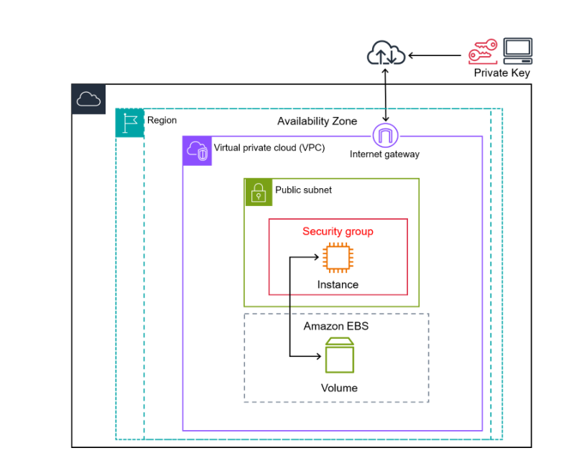
DEMONSTRATION

Slide 7


THANK'S FOR WATCHING

Slide 8

QNA
sonalivaigankar2@gmail.com

